Slide 1
Human Population Growth and the Environment
Human Population - An Explosive Growth
Human Needs - Limited Resources
Our Natural Environment Under Attack
Roles of Technology and Engineering
An Uncertain Future

Slide 2
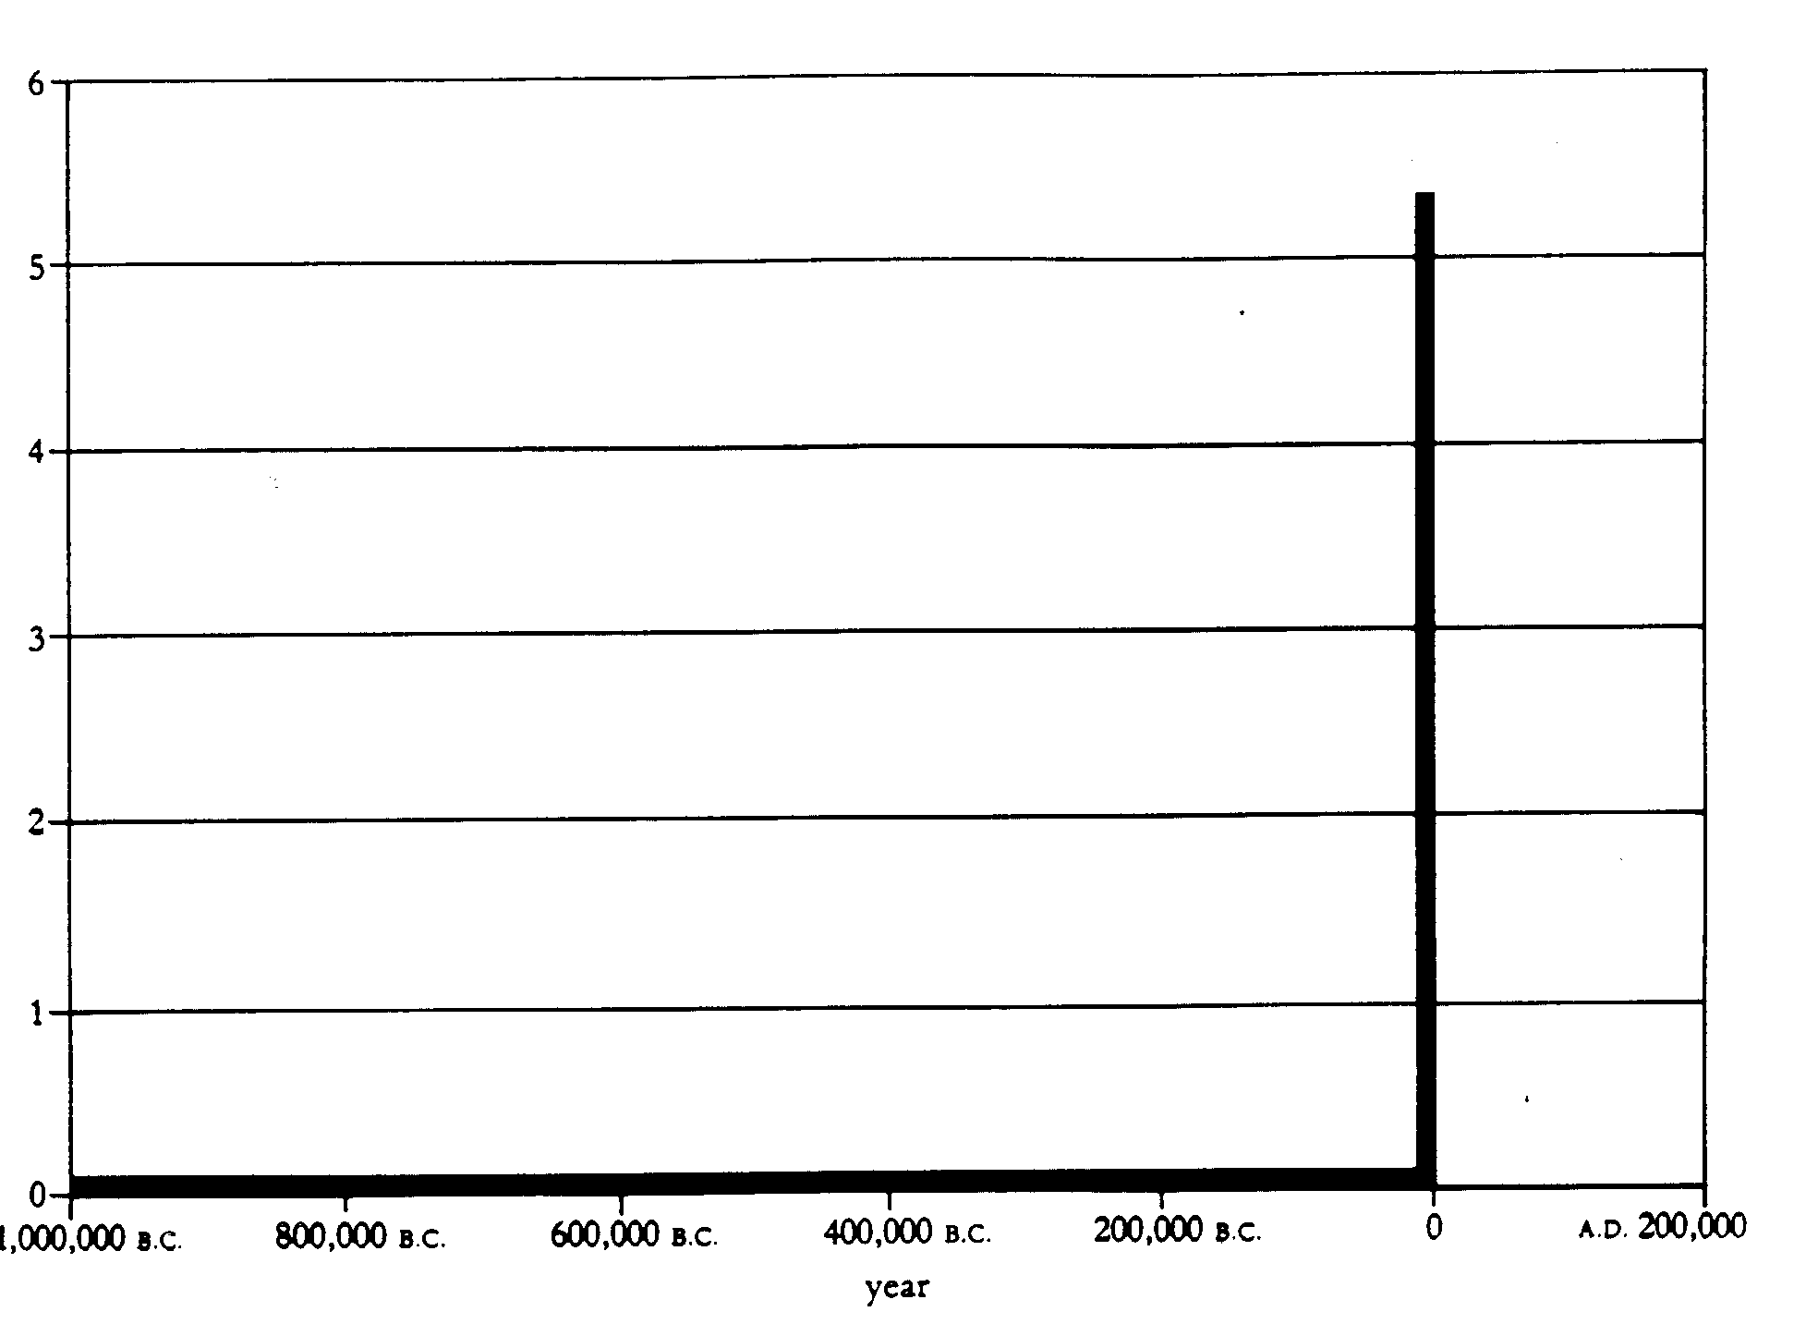
Humans are Recent Arrivals
Earth - 5 Billion Years
Multi-cell Biota - 600 Million Years
Human Beings ~ 2 Million Years
Human Population Growth into Billions - Last 200 years
6 Billion
6 Billion
A Million Years Of Human Growth (1)

Slide 3
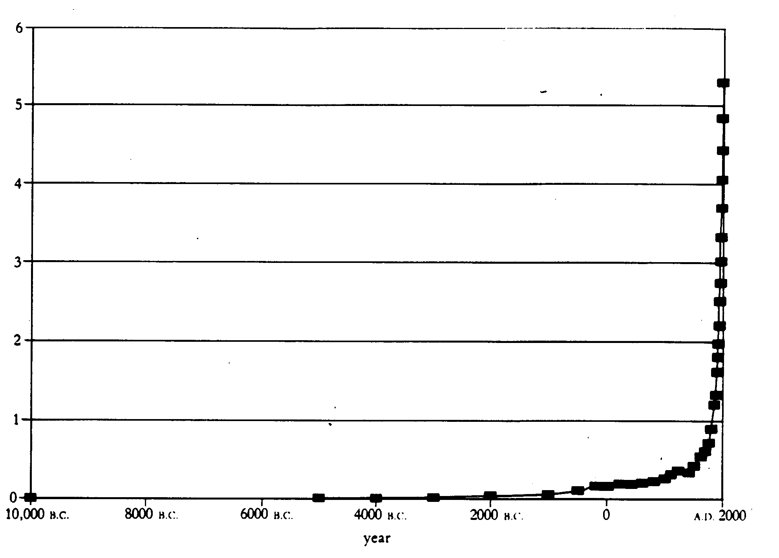
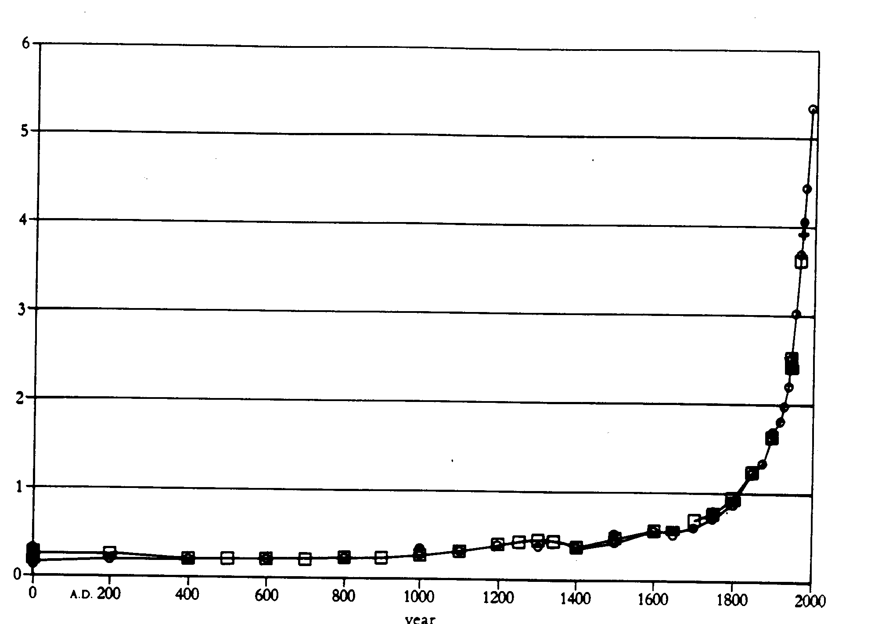
A Closer Look (1)
12,000 years
200 Million by 1 A.D.
2,000 Years
1 Billion in 1800 A.D.
The Industrial Revolution
1 Billion
200 million

Slide 4
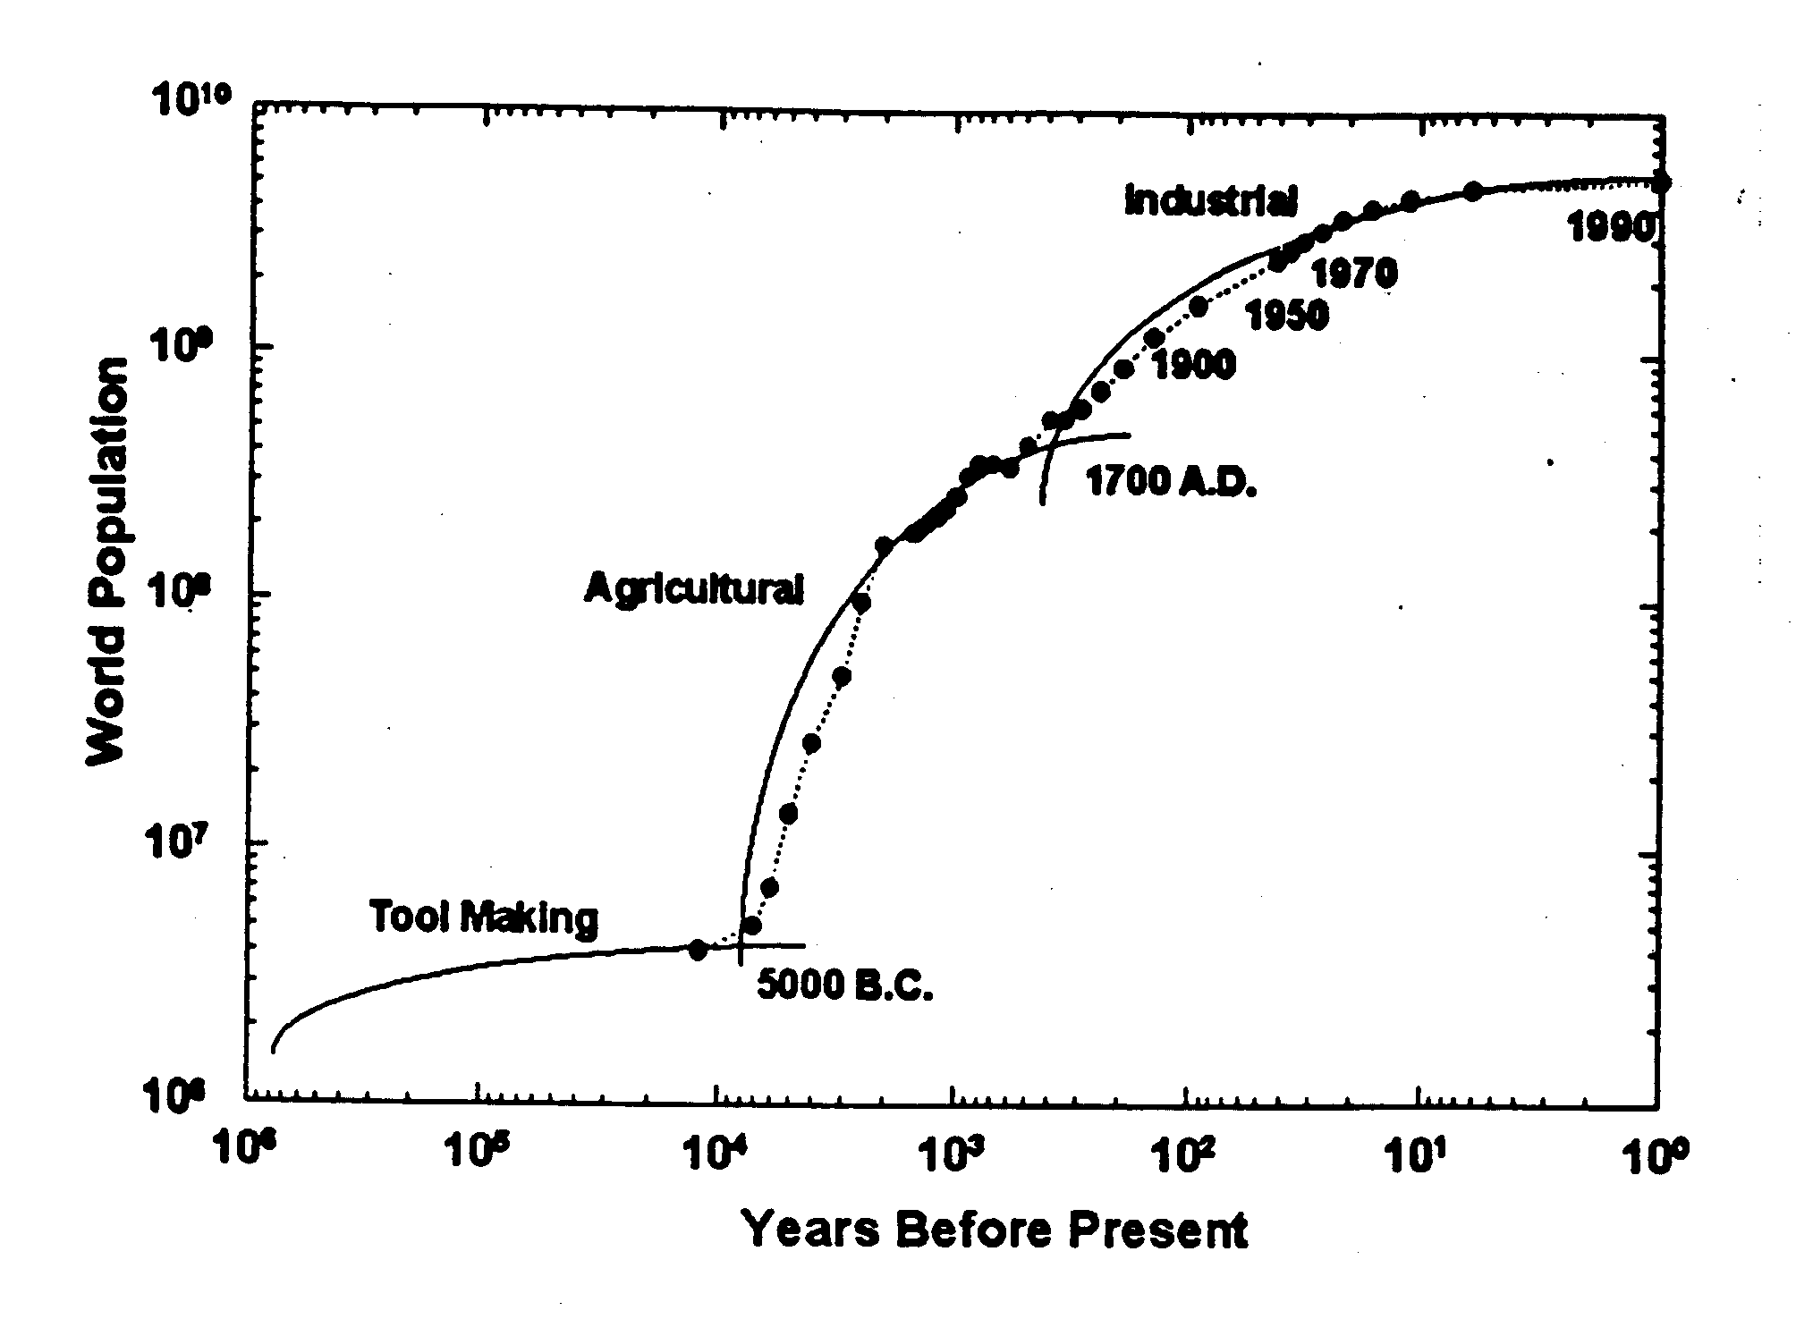
Three Technological Eras (2)

Slide 5
What’s Behind Population Growth
Three Factors
  Fertility
  Infant Mortality
  Longevity
Animal Domestication and Agriculture
  Provided for a few to feed many
Industrial Revolution
  Growth of Cities and Infrastructure
    Water
    Energy
    Transportation
  Increased Productivity
  Nutrition
  Sanitation
  Medicine

Slide 6
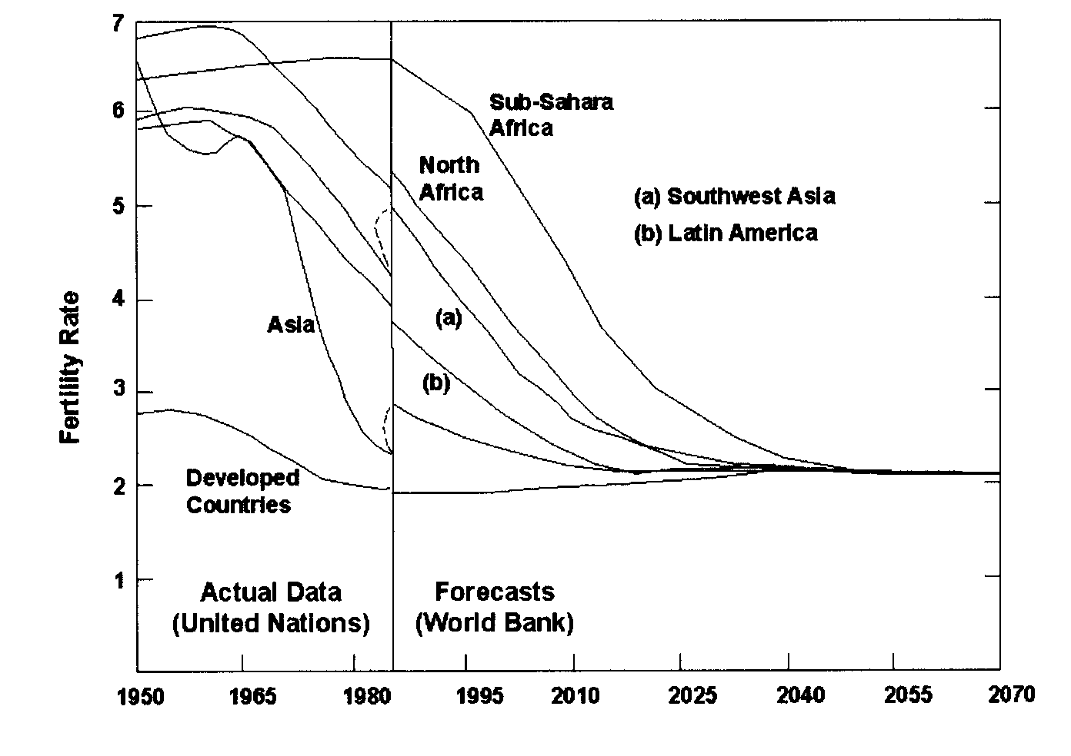
Fertility Trends
Population predictions are very sensitive to future fertility assumptions
At 1990 fertility rates (constant by region) population would grow to 110 billion in 2100, over 700 billion in 2150 (3)
Has been dropping since 1800 in developed nations - now at Zero Growth (4)
Is on its way down in much of the developing world (4)

Slide 7
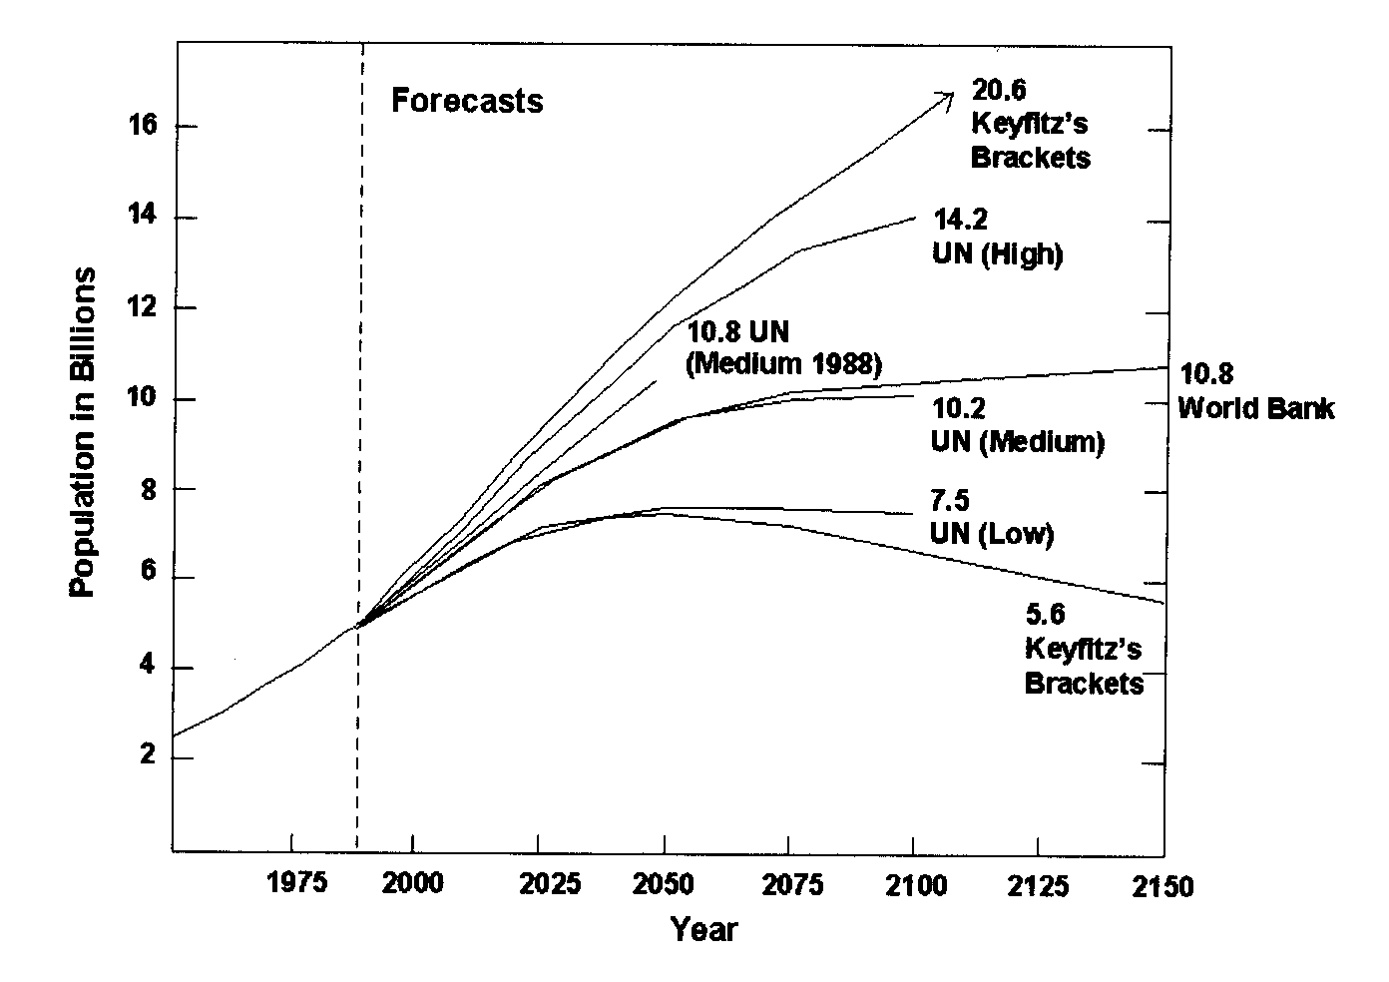
Population Predictions (4)
Most predictions: 9-12B by 2050 10-15B by 2100
UN (Low) requires global fertility at less than zero growth in 15 years
Large uncertainties

Slide 8
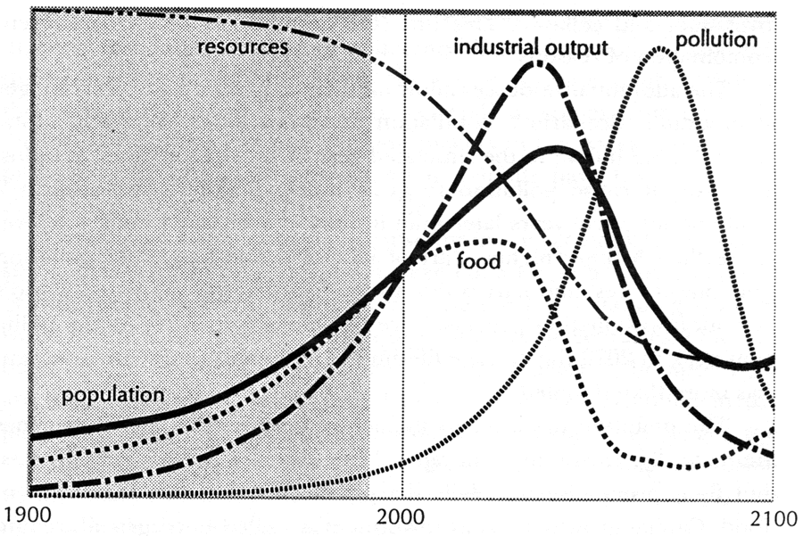
Population May Overshoot
When Population Outpaces Resources
Scenario - current population trend, doubled resources (5)

Slide 9
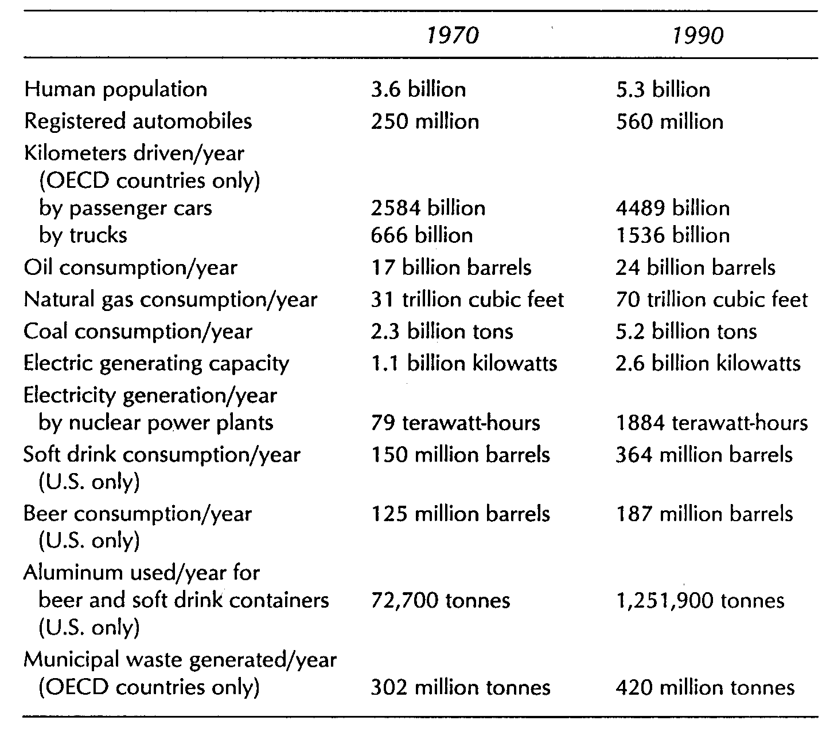
Resource Consumption (6)
High consumption
Getting worse
Rate increase faster than population growth

Slide 10
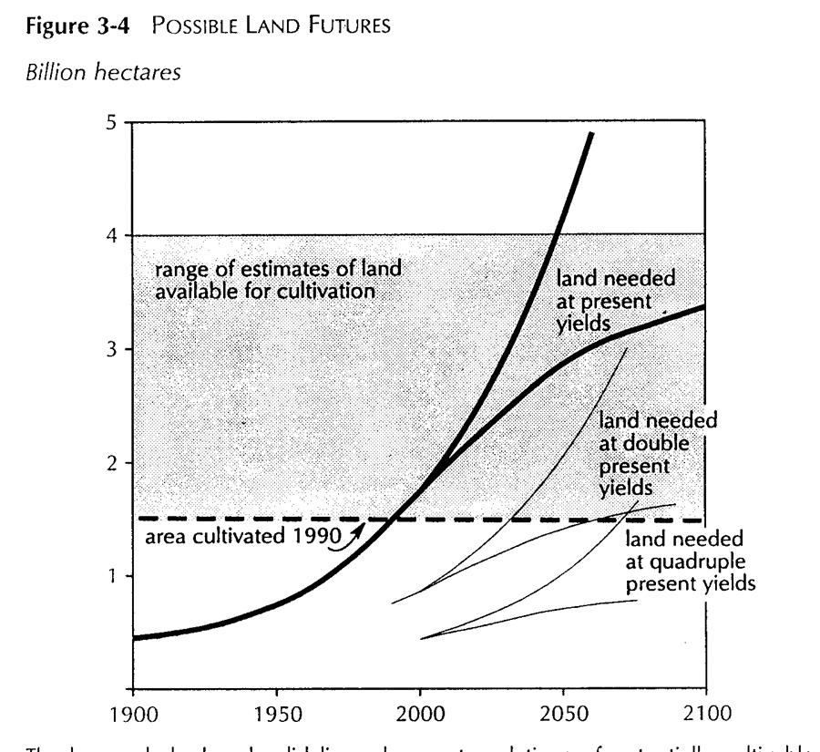
Resource Limits - Land (7)
Deforesting to acquire more arable land
Would run out in next century at current yields
Probably need to double yields

Slide 11
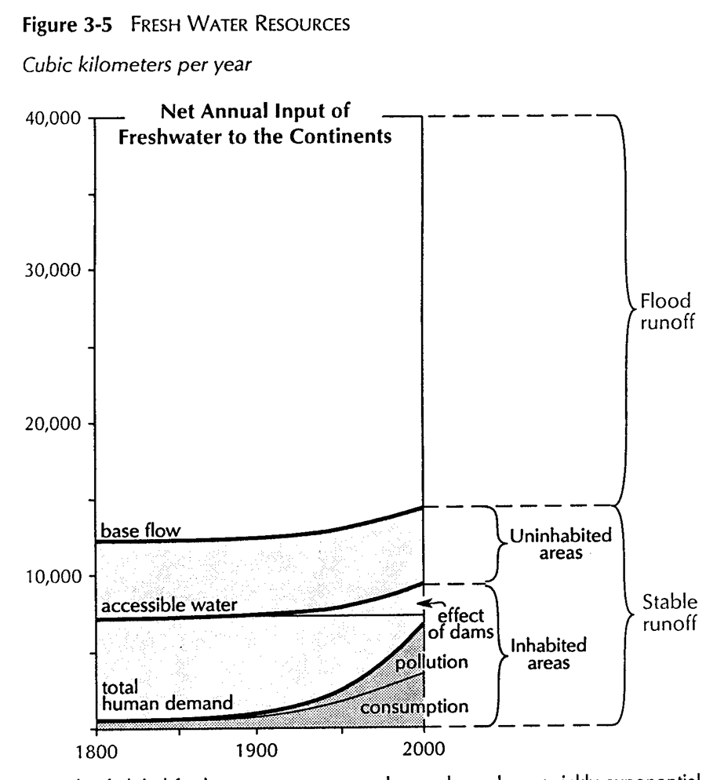
Resource Limits - Water (8)
In 1950 people used half of accessible water
Are now dependent on dams
Pollution loses 33% of potential water
Getting close to limits

Slide 12
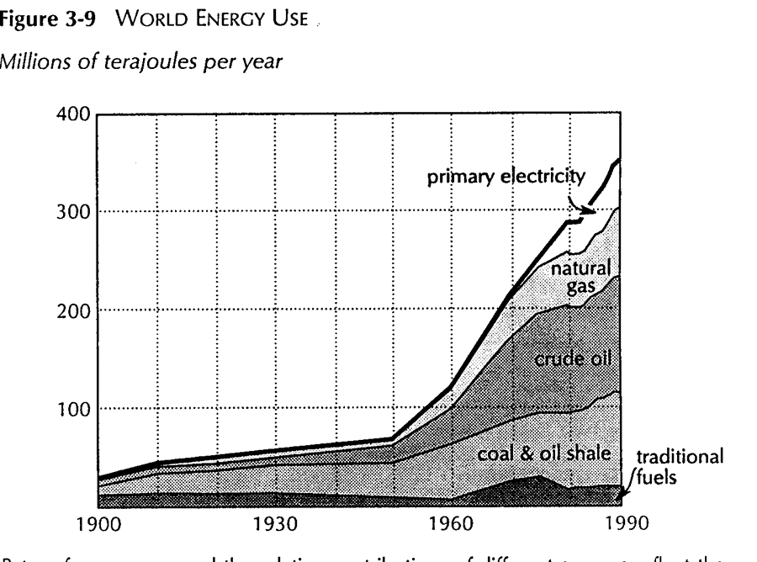
Energy Consumption (9)
Energy growth very high last fifty years
Mostly hydrocarbon fuels
Nonrenewable resource consumption and climate change issues

Slide 13
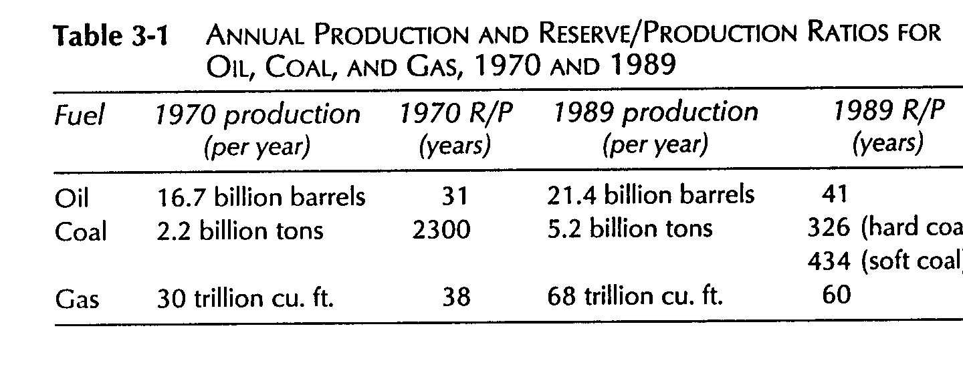
Fossil Fuel Reserves (9)
Lots of coal - but heavy CO2 contributor
Look for alternative forms of energy to emerge

Slide 14
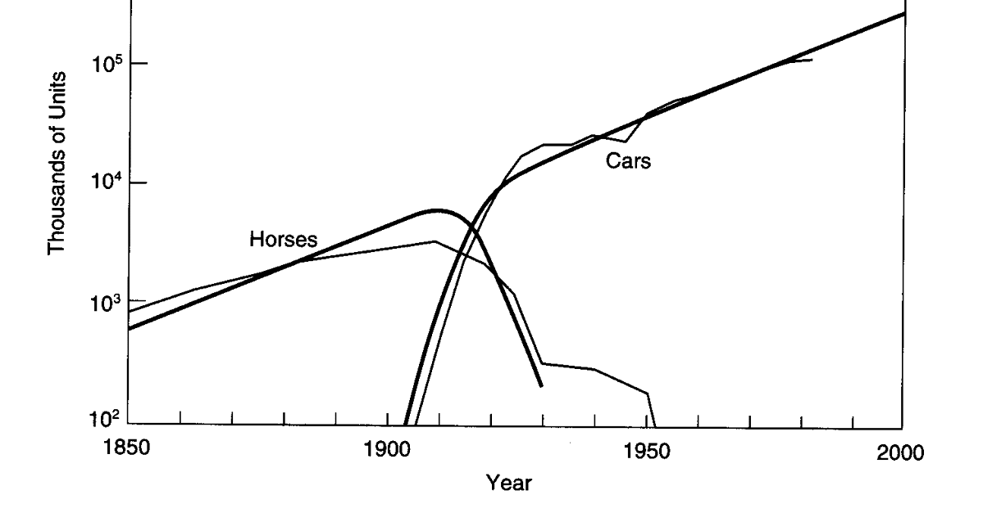
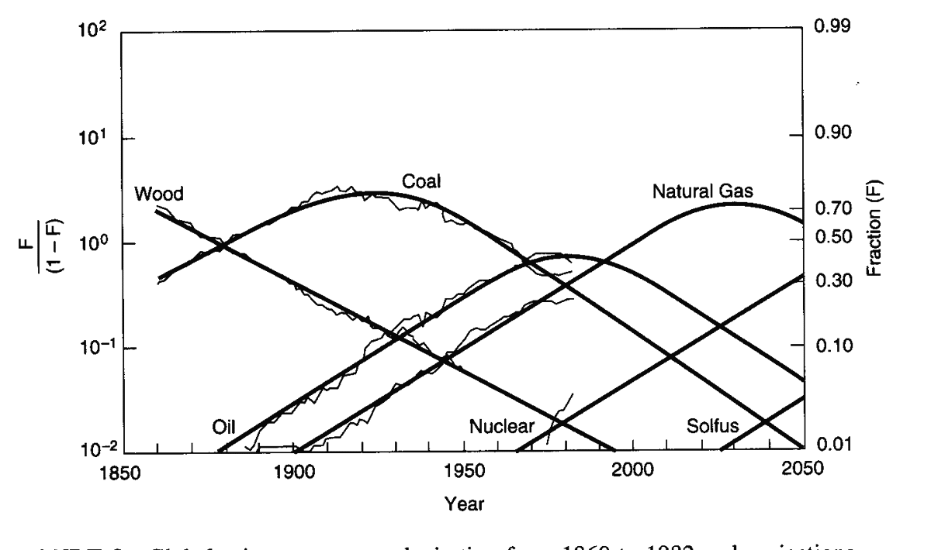
Technology Evolves (10)
Cars replaced horses as transportation needs grew
Energy forms have changed to meet changing needs
New economic and environmental needs are emerging

Slide 15
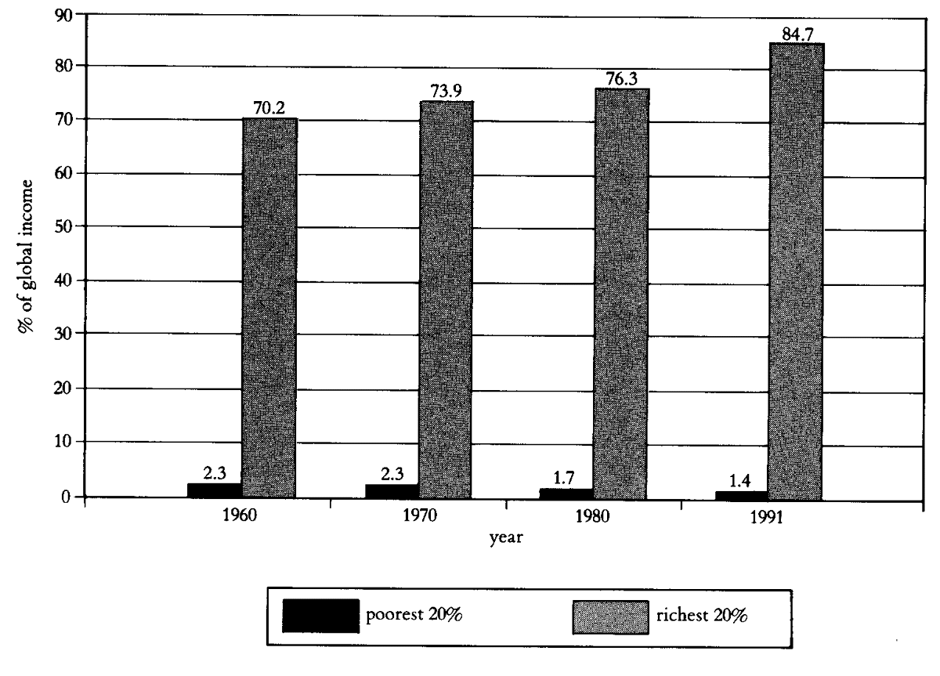
Economics and Resources (11)
1.1 billion people suffer from malnutrition
Impact = P*A*T
  Population
  Affluence
  Technology
US - 5% of global population but 20-25% of environmental impact
% of global income
84.7
1.4
Poorest 20%
Richest 20%

Slide 16
Planet Earth is Impacted (12)
Ecological Footprints
  United States - 5 hectares/person
  Developing nations - 0.5 hectare/person
For everyone to live at today’s US footprint would require 3 planet Earths
Increasing affluence and population is damaging Earth’s essential ecology

Slide 17
Our ‘Commons’ are in Danger
Atmospheric pollution and climate change
Water pollution, including ground aquifers
Deforestation and loss of oxygenation
The oceans, coral reefs and their bounty
National parks, wildernesses and wetlands
Nonrenewable natural resource depletion
  Fossil fuels, mineral ores, topsoil…..

Slide 18
Biodiversity is in Danger (13)
Humanity has spawned a species extinction to rival the 5 great extinctions of 65 - 440 million years ago
Recovery times from the great extinctions took 10’s of millions of years
Biodiversity is essential to life on Earth and holds untold treasures for the future
An ecological ethic is emerging

Slide 19
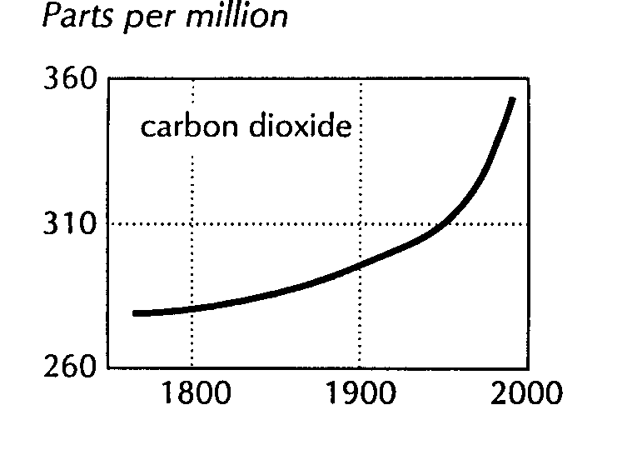
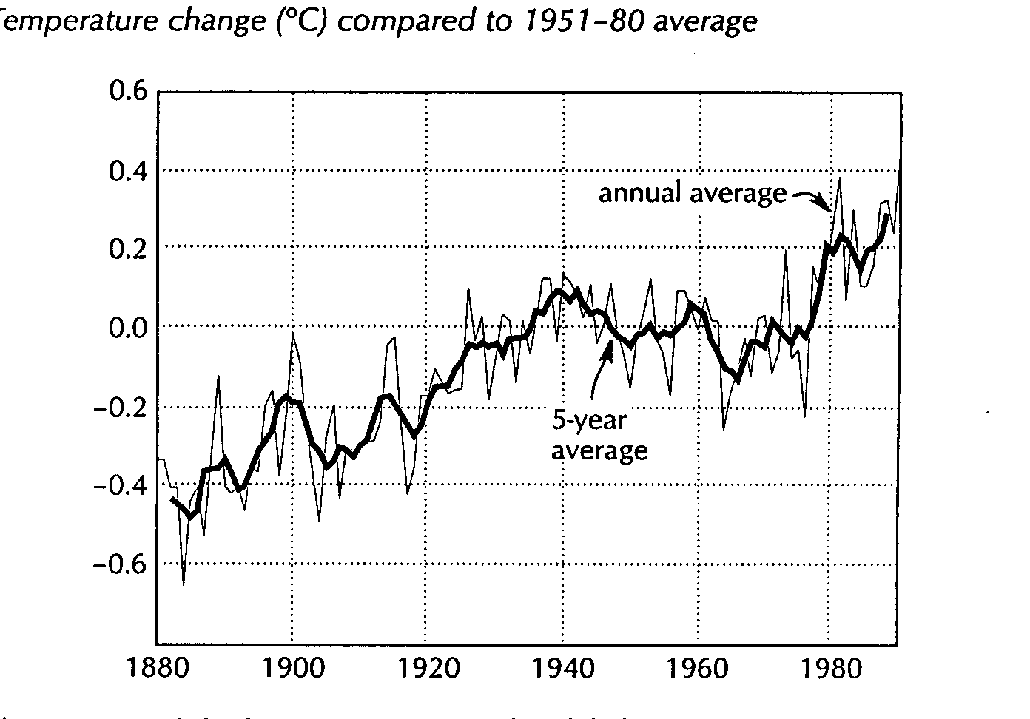
Global Warming - A Good Example
Atmospheric CO2 is increasing, and creates greenhouse effect.(14)
3-5°C rise predicted by computer models for this century would have major environmental impact. (15)
Observed change of 0.25-0.4°surface and 0.0-0.2°C troposphere rise in last 20 years doesn’t agree with models and may or may not be due to CO2.(16)
Humans - 6 billion tons/year of CO2 (up 500% from 1950, and increasing) (17)
  Other sources 200B tons/year
  Total atmosphere load - 775B tons
  Total earth load with oceans - 42,000B tons
0.6°C rise in last 100 years

Slide 20
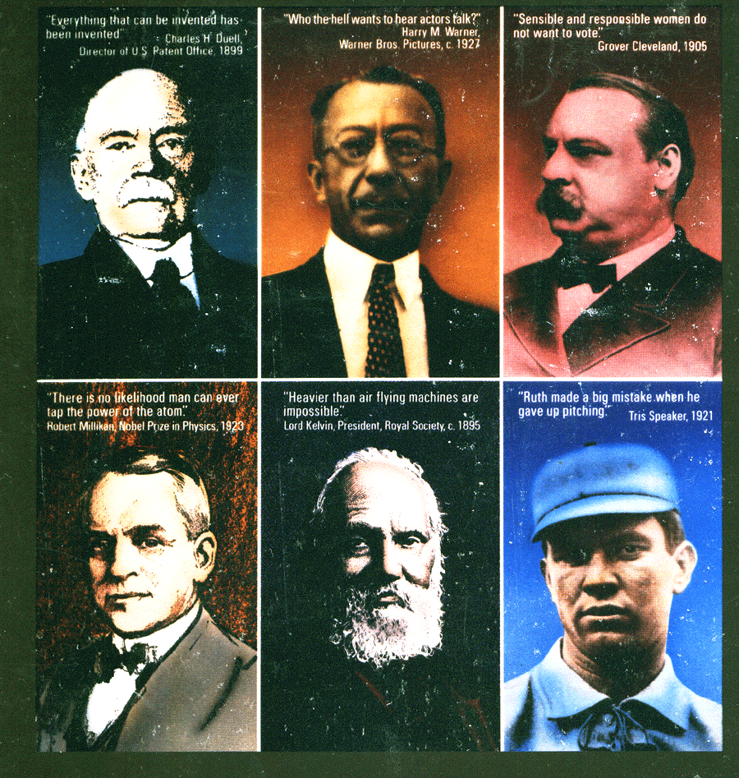
Predicting the Future - Be Careful
Don’t assume it cant be done
Leave room for the unknown
Consider alternatives carefully
Pursue all potential solutions

Slide 21
Technology’s Roles
Detailed explicit information and understanding of what is occurring
  Sensors, data processing, computers, models, predictions, communication, information…...
Alternate technologies that mitigate and eliminate deleterious effects
  Energy, water, transportation, communication…
Sustainable Development

Slide 22
Engineers are vital
Developing and applying
  the means by which to measure, analyze and predict future conditions
  the technologies by which to mitigate and eliminate undesired effects
Describing, explaining and communicating
  To policy makers
  To the non-technical public
Creating the framework for a sustainable environment

Slide 23
Summary
Major increases are occurring in human population and affluence.
Major stresses result in our society, natural environment, and ecology.
Technology and engineering are central to the creation and the mitigation of problems.
Predicting the future is difficult (17). The next twenty five to fifty years will be decisive.

Slide 24
References
1. Cohen, Joel, How Many People Can The Earth Support?, W. W. Norton & Co., New York, 1995, p79-82.
2. Kates, Robert, Population, technology, and the human environment: A thread through time, Technological Trajectories and the Human Environment, J Ausubel and H.D.Langford, Eds., National Academy Press, Washington, D.C., 1997, page 38 (concept credited to Deevey, E., The human population, Scientific American, 203, no.9 (September) 1960, pages 194-204.)
3. Cohen, op. cit., p139.
4. Kates, op cit., p50-51.
5. Meadows, Donella H.. et al, Beyond the Limits, Chelsea Green Publishing Co., White River Junction, Vermont, 1992, p128-140.
6. Meadows, op. cit., p7.

Slide 25
References, continued
7. Meadows, op cit., Chapter 3, The Limits: Sources and Sinks, p51.
8. Meadows, op cit., Chapter 3, The Limits: Sources and Sinks, p55.
9. Meadows, op cit., Chapter 3, The Limits: Sources and Sinks, p67-8.
10. Ausubel, J, and H.D.Langford, Eds., Technological Trajectories and the Human Environment, National Academy Press, Washington, D.C., 1997, p21 and 86
11. Cohen, op. cit., p52.
12. Wilson, Edward O., Foreword to 1999 edition, The Diversity of Life, W.W.Norton & Co., New York, 1992.
13. Wilson, E.O.,The Diversity of Life, W.W.Norton & Co., New York, 1992.
14..Meadows, op. cit, p92-96.
15. National Research Council, Reconciling Observations of Global Temperature Change, National Academy Press, Washington D.C., 2000
16. Dunn, Seth, Decarbonizing the energy economy in Brown, Lester et al, State of the World,W.W.Norton & Co., New York, 2001, page 85
17. Cerf, Christopher, and Victor Navansky, The Experts Speak, Pantheon Books, New York, 1984, revised 2000.

